Slide 1
Unit 4 Type I and Type II Error and Power

Slide 2
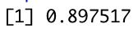
R Code for First Lightboard 4.3.1
power.t.test(n = 10,delta = 2, sd = 2, sig.level = .05, type = "one.sample",alternative = "one.sided")$power

Slide 3
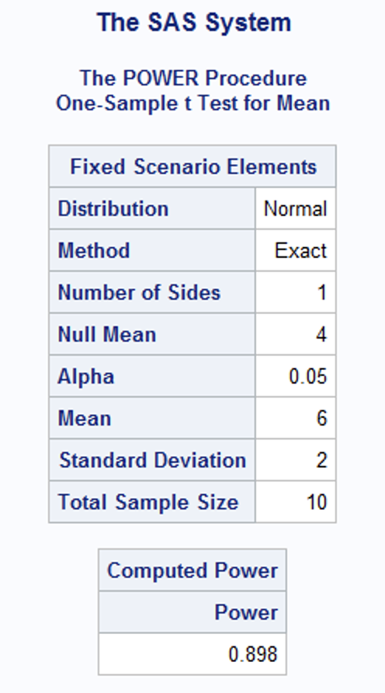
SAS Code for First Lightboard 4.3.1
proc power;
onesamplemeans test=normal
sides = 1
alpha = .05
nullmean = 4
mean = 6
stddev = 2
ntotal = 10
power = .;
run;

Slide 4
Explanation to the Try It!

Slide 5
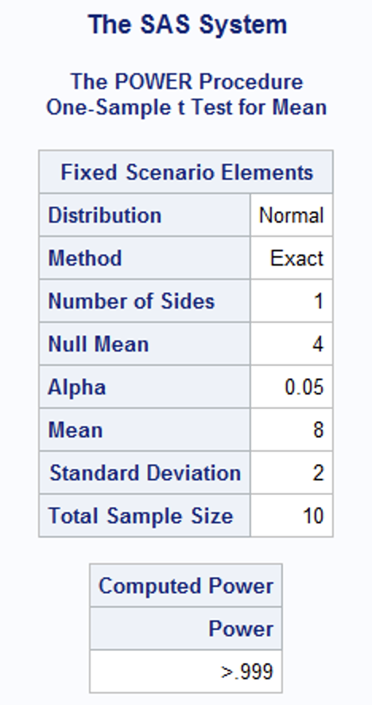
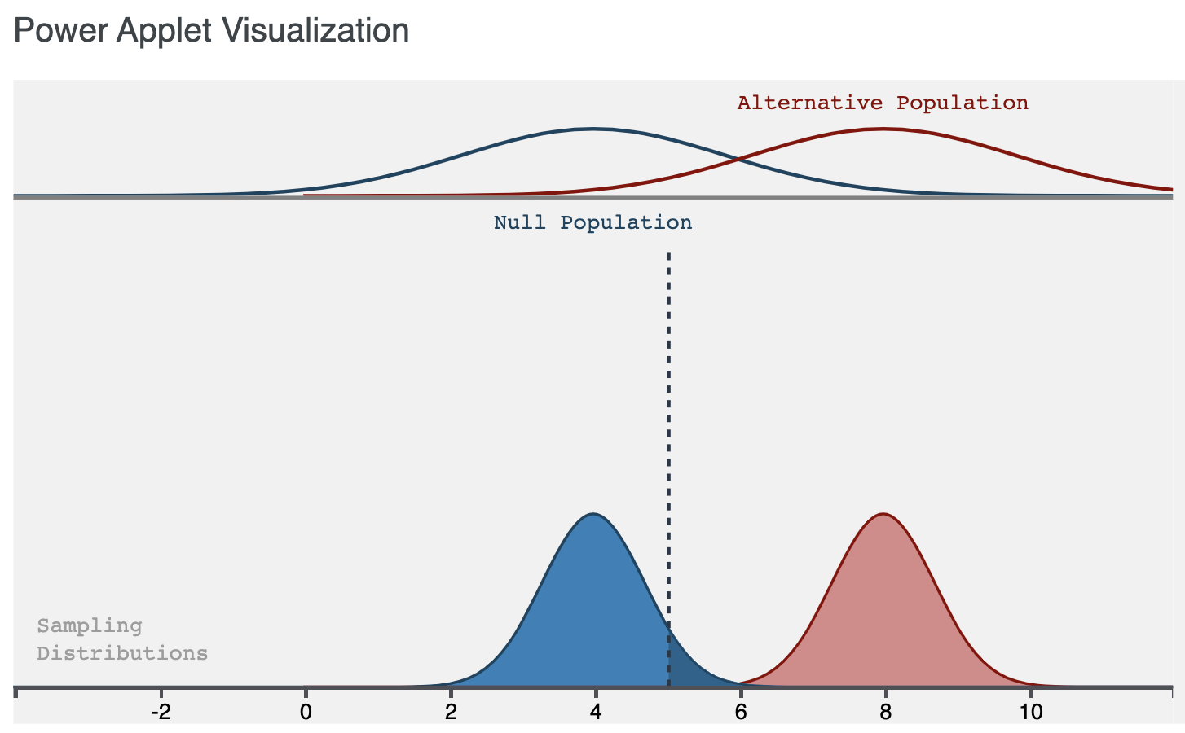
Solution to the Try It
Assume that the actual mean is now 8.
What is the effect size?
What is the power?
What is the probability of making a type I error?
What is the probability of making a type II error?
Try and draw the test and the alternative distribution and label all of the above.
proc power;
onesamplemeans
sides = 1
alpha = .05
nullmean = 4
mean = 8
stddev = 2
ntotal = 10
power = .;
run;
4
0.9999825
.05
.0000175

Slide 7
Explanation to the Try It!
Football

Slide 8
Type I, Type II Error and Power
Assume we want to test the claim that the mean SMU Football team attendance is more than 20,000 fans. In order to test this we selected 8 games at random and took the attendance from each game. The sample average from those 8 games was 20,450. Assume we know the sample standard deviation is 500 fans. Also assume the population of SMU football fans is normally distributed and that we have an alpha = .1 level of significance.
Find the probability of concluding that the mean is greater than 20,000 fans when the true mean really is 20,000 fans.
Find the probability of failing to reject the mean being less than or equal to 20,000 fans when the true mean really is 20,450 fans.

Slide 9

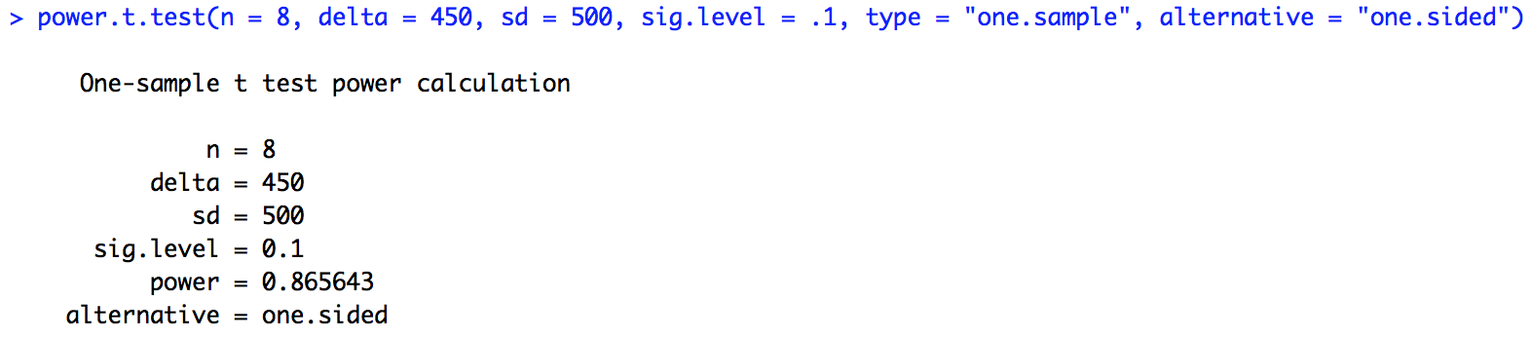

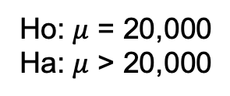
Type I, Type II Error and Power
Assume we want to test the claim that the mean SMU Football team attendance is more than 20,000 fans. In order to test this we selected 8 games at random and took the attendance from each game. The sample average from those 8 games was 20,450. Assume we know the sample standard deviation is 500 fans. Also assume the population of SMU football fans is normally distributed and that we have an alpha = .1 level of significance.
Find the probability of concluding that the mean is greater than 20,000 fans when the true mean really is 20,000 fans.
Alpha = 0.1
Find the probability of failing to reject the mean being less than or equal to 20,000 fans when the true mean really is 20,450 fans.
Beta = 1 – Power = 0.1344
Ho: $μ$ = 20,000
Ha: $μ$ > 20,000
FTR
Reject
$$α$$
20,000
20,450

Slide 10
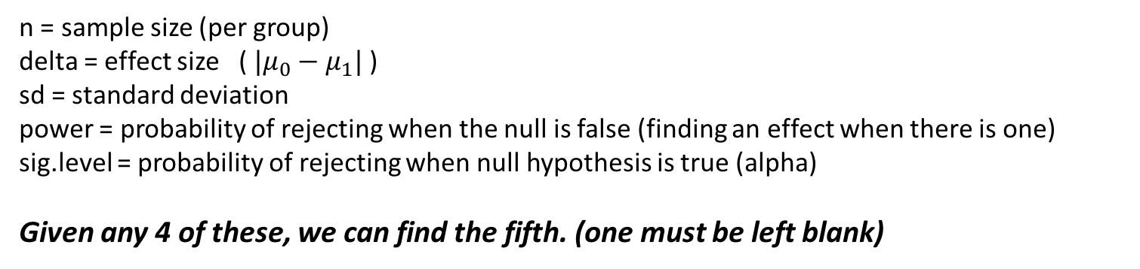
POWER.T.TEST
n = sample size (per group)
delta = effect size ( $|μ_{0}−μ_{1}|$ )
sd = standard deviation
power = probability of rejecting when the null is false (finding an effect when there is one)
sig.level = probability of rejecting when null hypothesis is true (alpha)
Given any 4 of these, we can find the fifth. (one must be left blank)

Slide 11
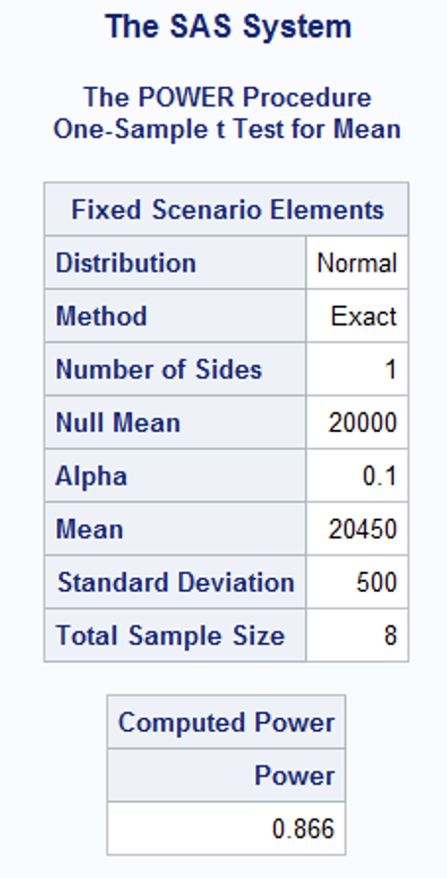
Proc Power
proc power;
onesamplemeans
sides = 1
alpha = .1
nullmean = 20000
mean = 20450
stddev = 500
ntotal = 8
power = .;
run;

Slide 13
Explanation to the Try It!
Time Lapse

Slide 14
Type 1, Type II Error and Power!
Randomly selected statistics students participated in an experiment to test their ability to determine when 1 min has passed. Forty students yielded a sample mean of 58.3 sec. Assuming that s = 9.5 sec, use a 0.05 level of significance to test the claim that the population mean is different from 60 sec.
Find the probability of concluding that the mean is different than 60 seconds when the true mean really is 60 seconds.
Find the probability of failing to reject the mean being equal to 60 seconds when the true mean is 61 seconds.
What happens to the power if we increase the effect size?

Slide 15
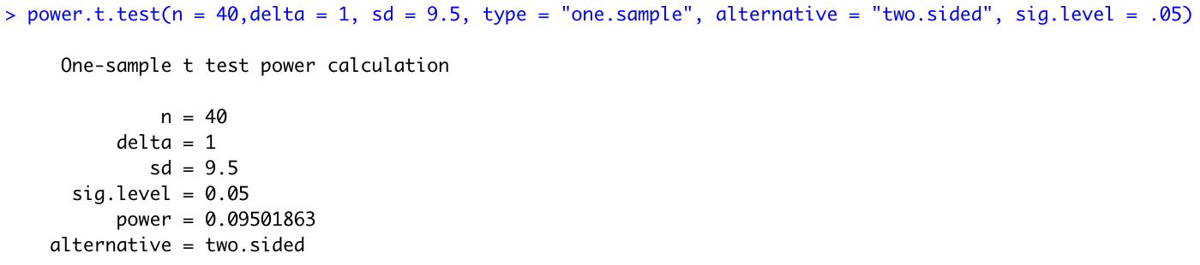
Type 1, Type II Error and Power!
Randomly selected statistics students participated in an experiment to test their ability to determine when 1 min has passed. Forty students yielded a sample mean of 58.3 sec. Assuming that s = 9.5 sec, use a 0.05 level of significance to test the claim that the population mean is different from 60 sec.
Find the probability of concluding that the mean is different than 60 seconds when the true mean really is 60 seconds.
Alpha = 0.05
Find the probability of failing to reject the mean being equal to 60 seconds when the true mean is 61 seconds.
Beta = 1 – Power = .905
What happens to the power if we increase the effect size?
As the effect size increases the power of the test increases.

Slide 16
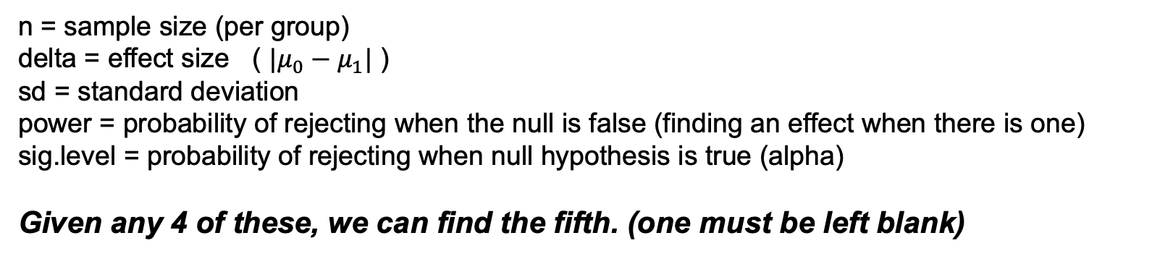
POWER.T.TEST
n = sample size (per group)
delta = effect size ( $|μ_{0}−μ_{1}|$ )
sd = standard deviation
power = probability of rejecting when the null is false (finding an effect when there is one)
sig.level = probability of rejecting when null hypothesis is true (alpha)
Given any 4 of these, we can find the fifth. (one must be left blank)

Slide 17
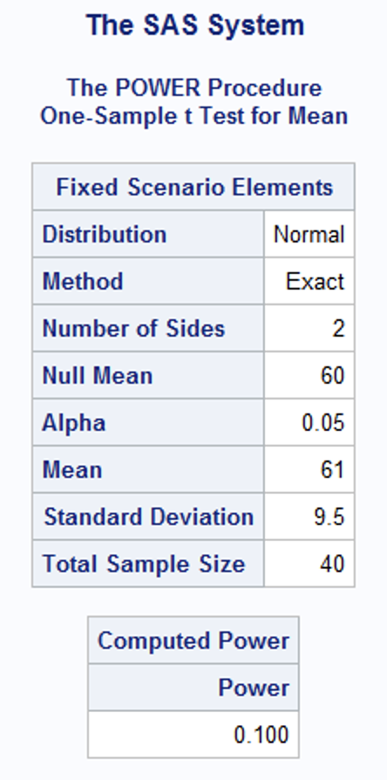
Proc Power
proc power;
onesamplemeans
sides = 2
alpha = .05
nullmean = 60
mean = 61
stddev = 9.5
ntotal = 40
power = .;
run;

Slide 19
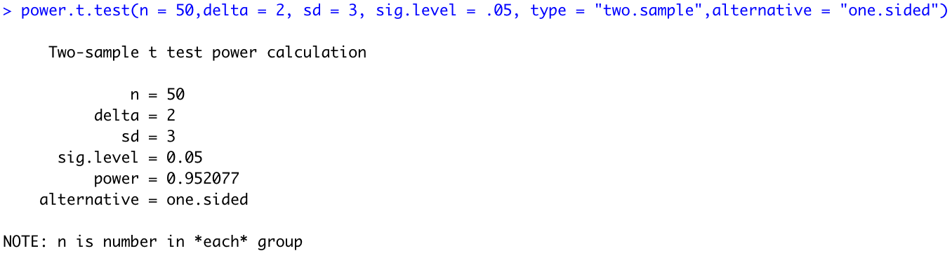
R Code for First Lightboard 4.4.1
power.t.test(n = 50,delta = 2, sd = 3, sig.level = .05, type = ”two.sample",alternative = "one.sided")$power

Slide 20
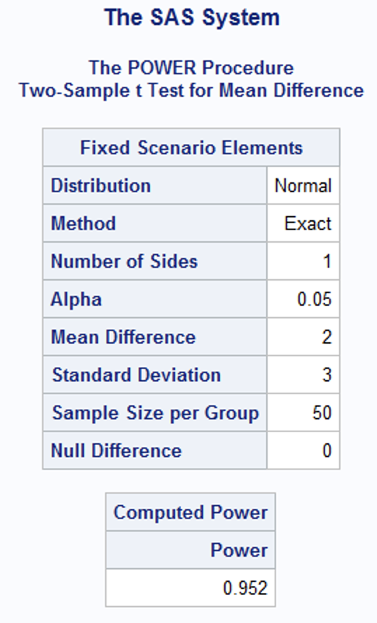
SAS Code for First Lightboard 4.4.1
proc power;
twosamplemeans
sides = 1
alpha = .05
meandiff = 2
stddev = 3
npergroup = 50
power = .;
run;

Slide 21
Explanation to the Try It!

Slide 22
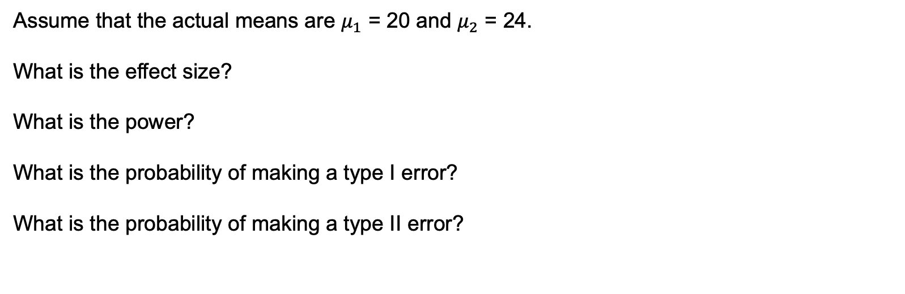
Solution to the Try It!
Assume that the actual means are $μ_{1}$ = 20 and $μ_{2}$ = 24.
What is the effect size?
What is the power?
What is the probability of making a type I error?
What is the probability of making a type II error?
4
.999999
.05
<.00001

Slide 24
Explanation to the Try It!
Marijuana and Memory Recall

Slide 25
Type I, Type II Error and Power
Many studies have been conducted to test the effects of marijuana use on mental abilities. In one such study, groups of light and heavy users of marijuana in college were tested for memory recall, with the results given below. Use a .01 significance level and a right tailed test to test the claim that the population of heavy marijuana users has a lower mean than the light users. Should marijuana use be of concern to college students? Assume all data comes from a normally distributed population. Assume the standard deviation is between the two sample standard deviations and can assumed to be 4 for both populations.
Items sorted correctly by light marijuana users: n = 65, xbar = 53.3, s = 3.6
Items sorted correctly by heavy marijuana users: n = 65, xbar = 51.3, s = 4.5
Find the probability of concluding that the mean memory recall of the heavy users is less than that of the light users when they are really equal (their difference really is zero.)
Find the probability that our test will conclude that there is no difference when the heavy users really have a mean that is 1.6 points less than that of the light users.
What happens to the power if we increase alpha?

Slide 26
Type I, Type II Error and Power
Many studies have been conducted to test the effects of marijuana use on mental abilities. In one such study, groups of light and heavy users of marijuana in college were tested for memory recall, with the results given below. Use a .01 significance level and a right tailed test to test the claim that the population of heavy marijuana users has a lower mean than the light users. Should marijuana use be of concern to college students? Assume all data comes from a normally distributed population. Assume the standard deviation is between the two sample standard deviations and can assumed to be 4 for both populations.
Items sorted correctly by light marijuana users: n = 65, xbar = 53.3, s = 3.6
Items sorted correctly by heavy marijuana users: n = 65, xbar = 51.3, s = 4.5
Find the probability of concluding that the mean of the heavy users is less greater than that of the light users when they are really equal (their difference really is zero.)
Alpha = .01

Slide 27
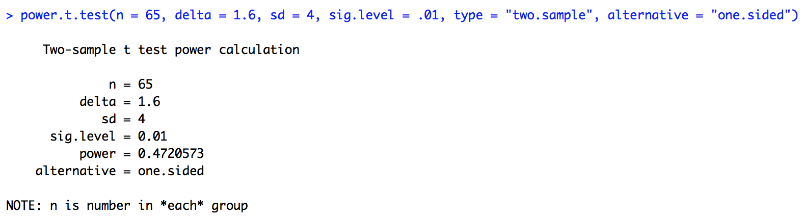
Type I, Type II Error and Power
Many studies have been conducted to test the effects of marijuana use on mental abilities. In one such study, groups of light and heavy users of marijuana in college were tested for memory recall, with the results given below. Use a .01 significance level and a right tailed test to test the claim that the population of heavy marijuana users has a lower mean than the light users. Should marijuana use be of concern to college students? Assume all data comes from a normally distributed population. Assume the standard deviation is between the two sample standard deviations and can assumed to be 4 for both populations.
Items sorted correctly by light marijuana users: n = 65, xbar = 53.3, s = 3.6
Items sorted correctly by heavy marijuana users: n = 65, xbar = 51.3, s = 4.5
Find the probability that our test will conclude that there is no difference when the heavy users really have a mean that is 1.6 points less than that of the light users.
Beta = 1 – Power = 1 - .472 = .528

Slide 28
Type I, Type II Error and Power
Many studies have been conducted to test the effects of marijuana use on mental abilities. In one such study, groups of light and heavy users of marijuana in college were tested for memory recall, with the results given below. Use a .01 significance level and a right tailed test to test the claim that the population of heavy marijuana users has a lower mean than the light users. Should marijuana use be of concern to college students? Assume all data comes from a normally distributed population. Assume the standard deviation is between the two sample standard deviations and can assumed to be 4 for both populations.
Items sorted correctly by light marijuana users: n = 65, xbar = 53.3, s = 3.6
Items sorted correctly by heavy marijuana users: n = 65, xbar = 51.3, s = 4.5
What happens to the power if we increase alpha?
Since the power is the probability of rejecting when the null hypothesis is false and rejecting the null becomes easier as alpha increases, the power increases as alpha increases.

Slide 29
POWER.T.TEST
n = sample size (per group)
delta = effect size ( $|μ_{0}−μ_{1}|$ )
sd = standard deviation
power = probability of rejecting when the null is false (finding an effect when there is one)
sig.level = probability of rejecting when null hypothesis is true (alpha)
Given any 4 of these, we can find the fifth. (one must be left blank)

Slide 30
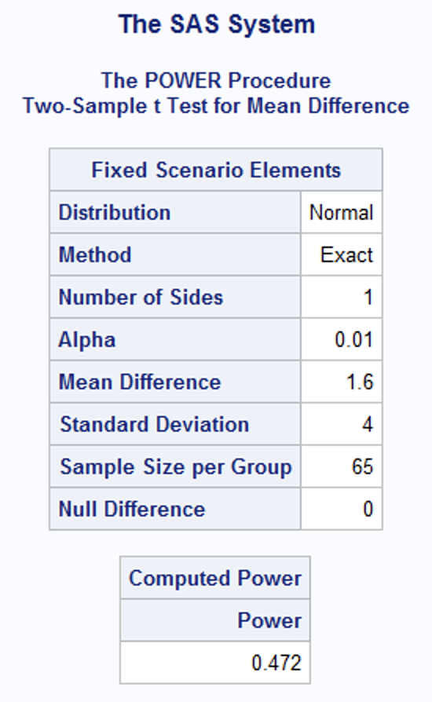
Proc Power
proc power;
twosamplemeans
sides = 1
alpha = .01
meandiff = 1.6
stddev = 4
npergroup = 65
power = .
;
run;

Slide 32
Power Curves: 1 Sample

Slide 33
Type I, Type II Error and Power
Assume we want to test the claim that the mean SMU Football team attendance is more than 20,000 fans. In order to test this we selected 8 games at random and took the attendance from each game. The sample average from those 8 games was 20,450. Assume we know the sample standard deviation is 500 fans. Also assume the population of SMU football fans is normally distributed and that we have an alpha = .1 level of significance.
Find the probability of concluding that the mean is greater than 20,000 fans when the true mean really is 20,000 fans.
Alpha = 0.1
Find the probability of failing to reject the mean being less than or equal to 20,000 fans when the true mean really is 20,450 fans.
Beta = 1 – Power = 0.1344
Ho: $μ$ = 20,000
Ha: $μ$ > 20,000
FTR
Reject
$$α$$
20,000
20,450

Slide 34
R Code
#Power Curve Code for One Sample Test
#Effect Size
powerholder = c()
effectsizes = seq(50,700,length = 20)
for(i in 1:20)
{
powerholder[i] = power.t.test(n = 8,delta = effectsizes[i], sd = 500, sig.level = .1, type = "one.sample",alternative = "one.sided")$power
}
plot(effectsizes,powerholder,type = "l", col = "blue", main = "POWER CURVE", ylab = "POWER", lwd = 3)
#Sample Size
powerholder = c()
samplesizes = seq(4,15,by = 1)
for(i in 1:12)
{
powerholder[i] = power.t.test(n = samplesizes[i],delta = 450, sd = 500, sig.level = .1, type = "one.sample",alternative = "one.sided")$power
}
plot(samplesizes,powerholder,type = "l", col = "blue", main = "POWER CURVE", ylab = "POWER", lwd = 3)

Slide 36
Power Curves: 2 Sample

Slide 37
Type I, Type II Error and Power
Many studies have been conducted to test the effects of marijuana use on mental abilities. In one such study, groups of light and heavy users of marijuana in college were tested for memory recall, with the results given below. Use a .01 significance level and a right tailed test to test the claim that the population of heavy marijuana users has a lower mean than the light users. Should marijuana use be of concern to college students? Assume all data comes from a normally distributed population. Assume the standard deviation is between the two sample standard deviations and can assumed to be 4 for both populations.
Items sorted correctly by light marijuana users: n = 65, xbar = 53.3, s = 3.6
Items sorted correctly by heavy marijuana users: n = 65, xbar = 51.3, s = 4.5
Find the probability of concluding that the mean of the heavy users is less greater than that of the light users when they are really equal (their difference really is zero.)
Alpha = .01
Find the probability that our test will conclude that there is no difference when the heavy users really have a mean that is 1.6 points less than that of the light users. (The effect size here is 1.6.)
Beta = 1 – Power = 1- .472 = .528
What happens to the power if we increase alpha?
Since the power is the probability of rejecting when the null hypothesis is false and rejecting the null becomes easier as alpha increases, the power increases as alpha increases.

Slide 38
R Code
# Power Curve Code for Two Sample T Test
#Effect Size
powerholder = c()
effectsizes = seq(.1,3,length = 20)
for(i in 1:20)
{
powerholder[i] = power.t.test(n = 65,delta = effectsizes[i], sd = 4, sig.level = .01, type = "two.sample",alternative = "one.sided")$power
}
plot(effectsizes,powerholder,type = "l", col = "blue", main = "POWER CURVE", ylab = "POWER", lwd = 3)
#Sample Size
powerholder = c()
samplesizes = seq(10,200,length = 20)
for(i in 1:20)
{
powerholder[i] = power.t.test(n = samplesizes[i], delta = 1.6, sd = 4, sig.level = .01, type = "two.sample",alternative = "one.sided")$power
}
plot(samplesizes,powerholder,type = "l", col = "blue", main = "POWER CURVE", ylab = "POWER", lwd = 3)

Slide 40
Airbag Inflators

Slide 41
Question of Interest
Key Safety Systems is a manufacturer of airbags and as such is interested in inflators. Inflators rapidly add air to the airbag in a fraction of second in order to help keep the passengers safe in the event of a crash. Assume that currently, key Safety Systems has an inflator that inflates the airbag in an average of 30 milliseconds but is considering upgrading the inflator to one that is state of the art. It costs millions of dollars to upgrade the inflator although they will receive many more contracts if they are able to decrease the average inflation time to less than 28.5 milliseconds.
The company has decided to hire you to investigate the true mean inflation time of the new inflator. You decide to assume that from inflator to inflator the standard deviation of the inflation times of the new inflator is the same as the old one (3 milliseconds). Your client would like to maintain at least a power of 80% to detect a decrease in mean inflation time if the true mean inflation time of the new inflator is 28.5 milliseconds. However, she is open to paying for a test with more power if it is cost effective. Since the new inflator has not reached production yet, each one will cost $1000 to include in the sample. She has indicated that she has $25,000 for the study and has come to you for advice on if she will be able to afford the study she needs and if not, what are the characteristics of the test she can afford.
You decide to calculate the sample size needed to achieve the 80% power for the effect size of 1 but also decide to include a power curve that will show the change in power for sample sizes close to the one needed for 80% power.
The company’s representative decides to pay for a test that has 90% power and the sample is obtained with the following results:
26.31 29.55 33.76 25.61 28.76 29.40 31.12 28.28 34.95 28.58 30.25 31.95 27.82 25.88 34.35 22.07 31.64 29.11 32.04 30.30 35.27 25.40 33.77 34.86 29.01 21.64 30.43 27.21 31.38 29.87 31.22 29.96 32.23 28.15 26.67 27.21 23.82
You then conduct a complete analysis with this data and formally present the results to the representative and the CEO of the company.

Slide 43
Presenting Power Results

Slide 44
Power Analysis for Key Safety Systems

Slide 45
Power Analysis
Parameters and Assumptions
Effect Size | 1.5 milliseconds (Response Time = 28.5 milliseconds)
Standard Deviation | 3 milliseconds
Power | 80%
Significance Level | 5%
Sample Size | Power
25 | 78.3%
26 | 79.8%
27 | 81.2%
Required Sample Size: 27
Actual Power Achieved: 81.2%

Slide 46
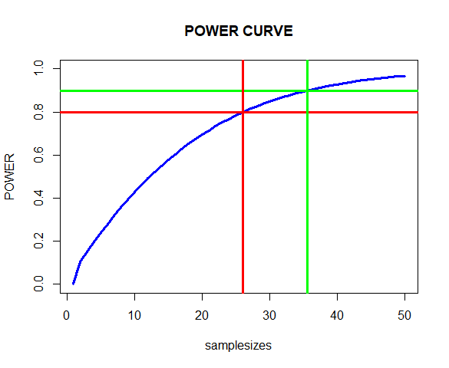
Power Analysis
Parameters and Assumptions
Effect Size | 1.5 milliseconds (Response Time = 28.5 milliseconds)
Standard Deviation | 3 milliseconds
Power | 80%
Significance Level | 5%
91%
n = 37
Sample Size | Power
20 | 69.5%
25 | 78.3%
30 | 84.8%
35 | 89.5%
40 | 95.1%
80%
n = 27

Slide 48
A Complete Analysis

Slide 49
Question of Interest
Is there sufficient evidence to suggest that the new state-of-the-art inflator has a mean inflation time that is more than 1.5 milliseconds less than the current one that is known to be 30 milliseconds.
set.seed(2)
TheSample = round(rnorm(37,28.5,3),2)
TheSample
write.csv(TheSample,"SampleOfInflators.csv")
In order to test this question of interest the client provided a sample of 37 inflators in order to achieve a power of 91% to detect an effect size of more than 1.5 milliseconds. These 37 inflators were manufactured for this test at the New Mexico facility from January 8 to January 10, 2020.

Slide 50
Assumptions
Assumptions:
Normality: The histogram and qqplot are fairly consistent with a normally distributed population although there is some evidence of a left skew. Given the fact we have 37 observations, we will assume that this assumption is either met or that the t-test is robust to this assumption.
Independent: The inflators had to be manufactured for the sample thus they are a sample of the theoretical population of inflators that could have been produced. However, the time and location of manufacturing was essentially fixed which casts some concerns over the independence of the observations if the population is considered to be all inflators that will ever be produced. We will note this concern and proceed with caution.
set.seed(2)
TheSample = round(rnorm(37,28.5,3),2)
TheSample
write.csv(TheSample,"SampleOfInflators.csv")

Slide 51
Inflator Analysis
Assumptions:
Normality: The histogram and qqplot are fairly consistent with a normally distributed population although there is some evidence of a left skew. Given the fact we have 37 observations, we will assume that this assumption is either met or that the t-test is robust to this assumption.
Independent: The inflators had to be manufactured for he sample thus they are a sample of the theoretical population of inflators that could have been produced. However, the time and location of manufacturing was essentially fixed which casts some concerns over the independence of the observations if the population is considered to be all inflators that will ever be produced. We will note this concern and proceed with caution.
set.seed(2)
TheSample = round(rnorm(37,28.5,3),2)
TheSample
write.csv(TheSample,"SampleOfInflators.csv")
Hypothesis Test:
Step 1:
Step 2:
Step 3:
Step 4:
Step 5:
Step 6: Conclusion

Slide 52
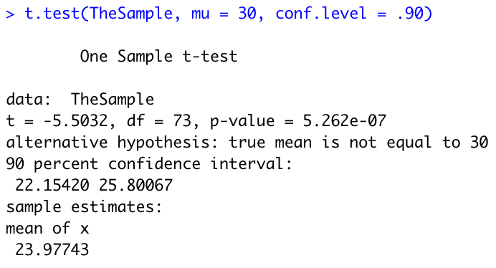
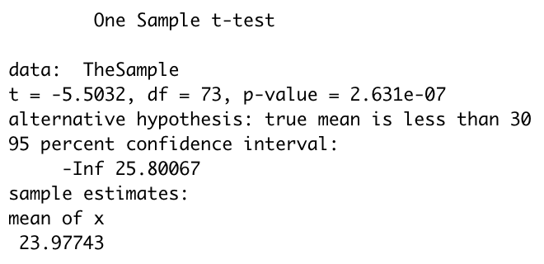
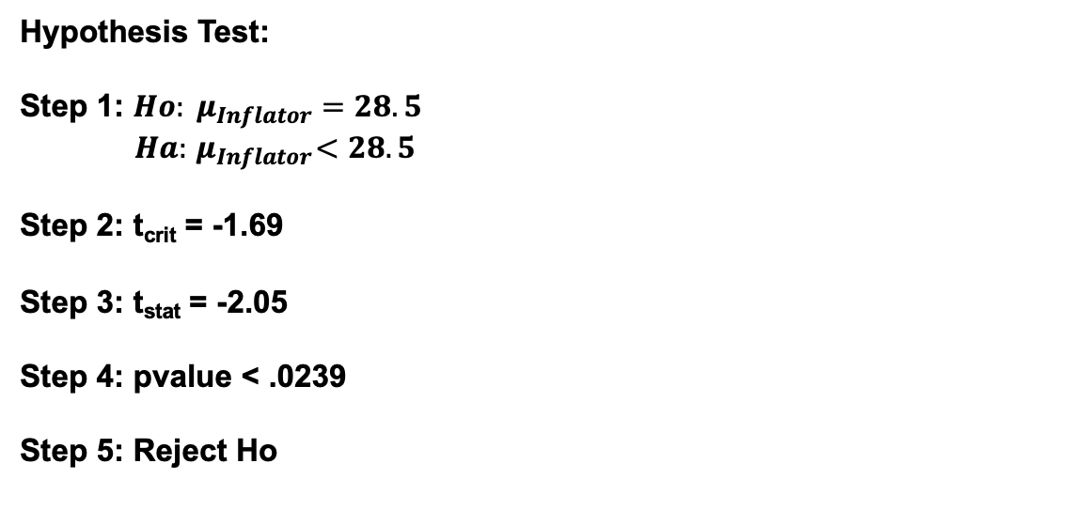
Hypothesis Test
Assumptions:
Normality: The histogram and qqplot are fairly consistent with a normally distributed population although there is some evidence of a left skew. Given the fact we have 37 observations, we will assume that this assumption is either met or that the t-test is robust to this assumption.
Independent: The inflators had to be manufactured for he sample thus they are a sample of the theoretical population of inflators that could have been produced. However, the time and location of manufacturing was essentially fixed which casts some concerns over the independence of the observations if the population is considered to be all inflators that will ever be produced. We will note this concern and proceed with caution.
set.seed(2)
TheSample = round(rnorm(37,28.5,3),2)
TheSample
write.csv(TheSample,"SampleOfInflators.csv")
Hypothesis Test:
Step 1: $Ho: μ_{Inflator}=28.5$
$Ha:{ μ}_{Inflator}<28.5$
Step 2: t_{crit} = -1.69
Step 3: t_{stat} = -2.05
Step 4: pvalue < .0239
Step 5: Reject Ho
Step 6: There is sufficient evidence to suggest that the new state of the art inflator has a mean inflation time that is more than 1.5 milliseconds less than the current inflator (pvalue <.0001). A 90% confidence interval for the mean inflation time is (22.15 ms, 25.80 ms) which implies that we are 90% confident that the decrease in the mean inflation time associated with the new inflator is (4.20 ms, 7.85 ms).

Slide 54
Presentation to the Customer

Slide 55
Final Presentation for Key Safety Systems Dr. Bivin Sadler bsadler@smu.edu

Slide 56
Question of Interest
Is there sufficient evidence to suggest that the new state-of-the-art inflator has a mean inflation time that is less than 28.5 milliseconds.
set.seed(2)
TheSample = round(rnorm(37,28.5,3),2)
TheSample
write.csv(TheSample,"SampleOfInflators.csv")
In order to test this question of interest:
You provided a sample of 37 inflators
These 37 inflators were manufactured for this test at the New Mexico facility from January 8 to January 10, 2020.
This provided a test with 91% power
SD = 3 milliseconds
Effect size of more than 1.5 milliseconds.

Slide 57
Inflation Times: At a Glance
set.seed(2)
TheSample = round(rnorm(37,28.5,3),2)
TheSample
write.csv(TheSample,"SampleOfInflators.csv")
Min | 21.14
25th Percentile | 26.65
Median | 27.88
54th Percentile | 28.5
75th Percentile | 29.46
Max | 31.26
Mean | 27.66

Slide 58
Inflation Times: At a Glance
Min | 21.14
25th Percentile | 26.65
Median | 27.88
54th Percentile | 28.5
75th Percentile | 29.46
Max | 31.26
Mean | 27.66
set.seed(2)
TheSample = round(rnorm(37,28.5,3),2)
TheSample
write.csv(TheSample,"SampleOfInflators.csv")
Conclusion: There is sufficient evidence to suggest that the new state of the art inflator has a mean inflation time that is more than 1.5 milliseconds less than the current inflator (pvalue <.0239). A 90% confidence interval for the mean inflation time is (26.96 ms, 28.35 ms) which implies that we are 90% confident that the decrease in the mean inflation time associated with the new inflator is (0.15 ms, 1.54 ms).
Scope: Since these 37 inflators were manufactured for this study, they can be thought of as a sample of the population of inflators that could have been manufactured and that will be manufactured if you move forward with this inflator. If you think this is reasonable then these results could be assumed apply to the new inflators as a whole …. Keeping in mind that they are manufactured at the New Mexico facility.

Slide 59
Appendix

Slide 60
Assumptions
Assumptions:
Normality: The histogram and qqplot are fairly consistent with a normally distributed population although there is some evidence of a left skew. Given the fact we have 37 observations, we will assume that this assumption is either met or that the t-test is robust to this assumption.
Independent: The inflators had to be manufactured for the sample thus they are a sample of the theoretical population of inflators that could have been produced. However, the time and location of manufacturing was essentially fixed which casts some concerns over the independence of the observations if the population is considered to be all inflators that will ever be produced. We will note this concern and proceed with caution.
set.seed(2)
TheSample = round(rnorm(37,28.5,3),2)
TheSample
write.csv(TheSample,"SampleOfInflators.csv")

Slide 61
Hypothesis Test
Assumptions:
Normality: The histogram and qqplot are fairly consistent with a normally distributed population although there is some evidence of a left skew. Given the fact we have 37 observations, we will assume that this assumption is either met or that the t-test is robust to this assumption.
Independent: The inflators had to be manufactured for he sample thus they are a sample of the theoretical population of inflators that could have been produced. However, the time and location of manufacturing was essentially fixed which casts some concerns over the independence of the observations if the population is considered to be all inflators that will ever be produced. We will note this concern and proceed with caution.
set.seed(2)
TheSample = round(rnorm(37,28.5,3),2)
TheSample
write.csv(TheSample,"SampleOfInflators.csv")
Hypothesis Test:
Step 1: $Ho: μ_{Inflator}=28.5$
$Ha:{ μ}_{Inflator}<28.5$
Step 2: t_{crit} = -1.69
Step 3: t_{stat} = -2.05
Step 4: pvalue < .0239
Step 5: Reject Ho
Step 6: There is sufficient evidence to suggest that the new state of the art inflator has a mean inflation time that is more than 1.5 milliseconds less than the current inflator (pvalue <.0001). A 90% confidence interval for the mean inflation time is (22.15 ms, 25.80 ms) which implies that we are 90% confident that the decrease in the mean inflation time associated with the new inflator is (4.20 ms, 7.85 ms).

